Slide 1
Stub Automation

Slide 2
Overview
Stub automation is a web based application which can help developers to get rid of problems they face with mock JSON while developing their application till actual API to be consumed is not available.
Problem Statement
As of now while development we have to hard code the mock JSON and every time we need to edit the hard coded JSON we have to re-build the application which is a quite time taking process. Also, in case API to be consumed is not available or environment is down we were not able to test.
Solution
Keeping all these problems in consideration, Stub Automation allows a user to create a repository for their API's where they can create a stub for response and can access that stub (or mock JSON) through a URL for each of their API.

Slide 3
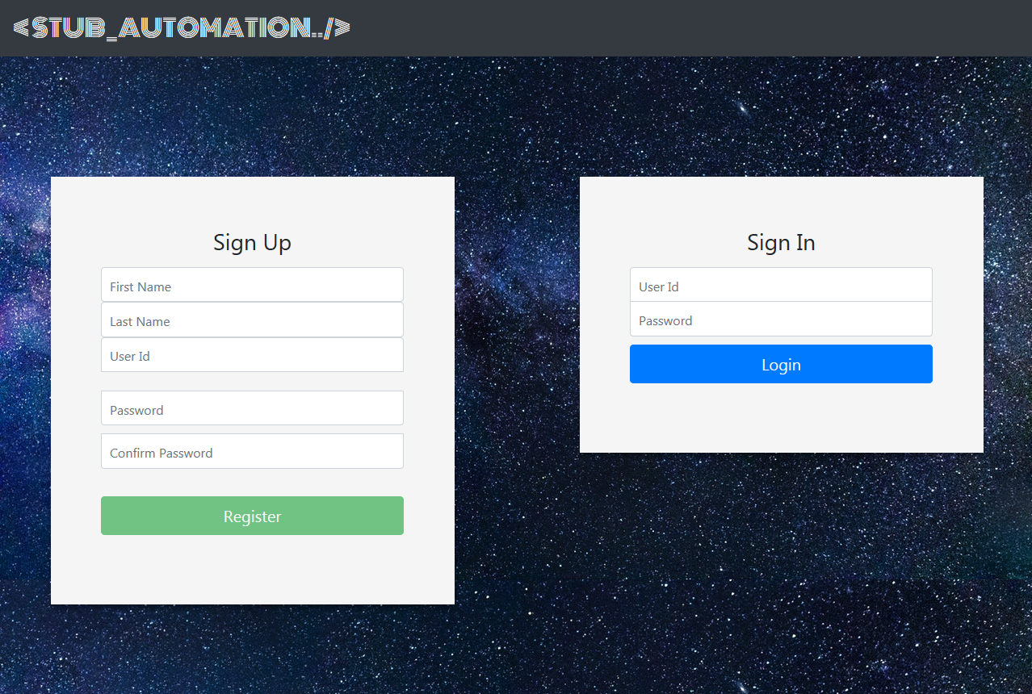
Login/Signup Page

Slide 4
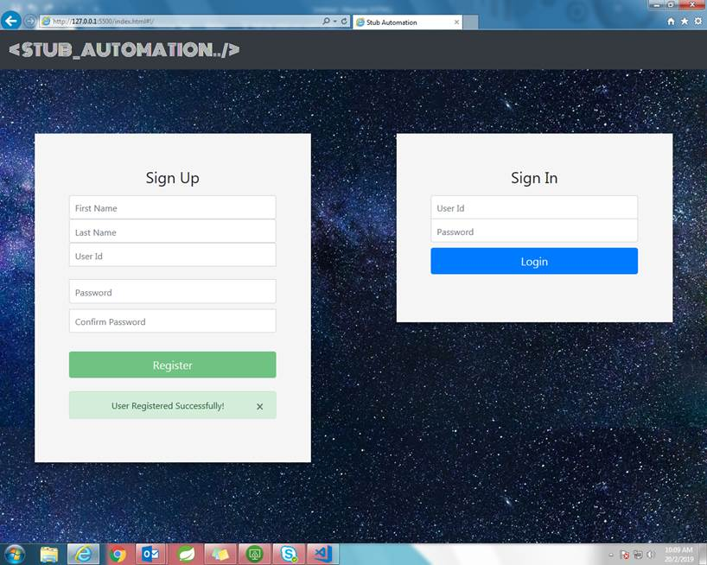
Login/Signup Page: Successful signup

Slide 5
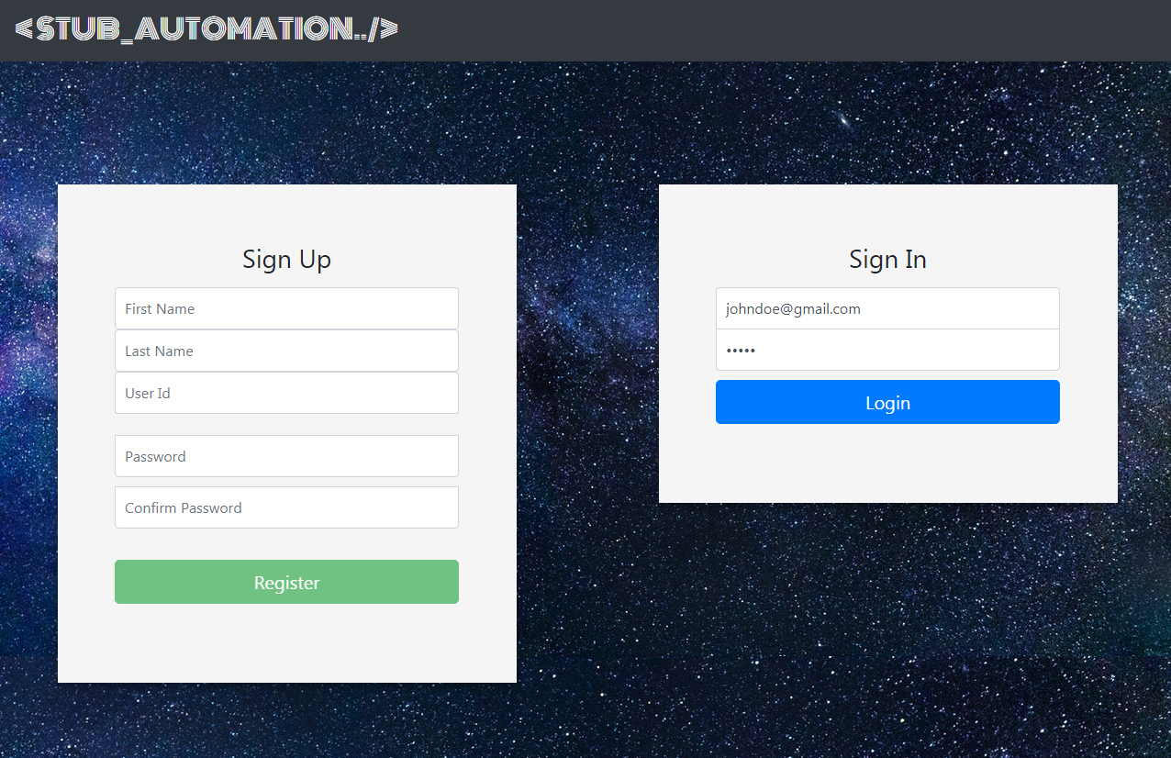
Login/Signup Page: SignIn

Slide 6
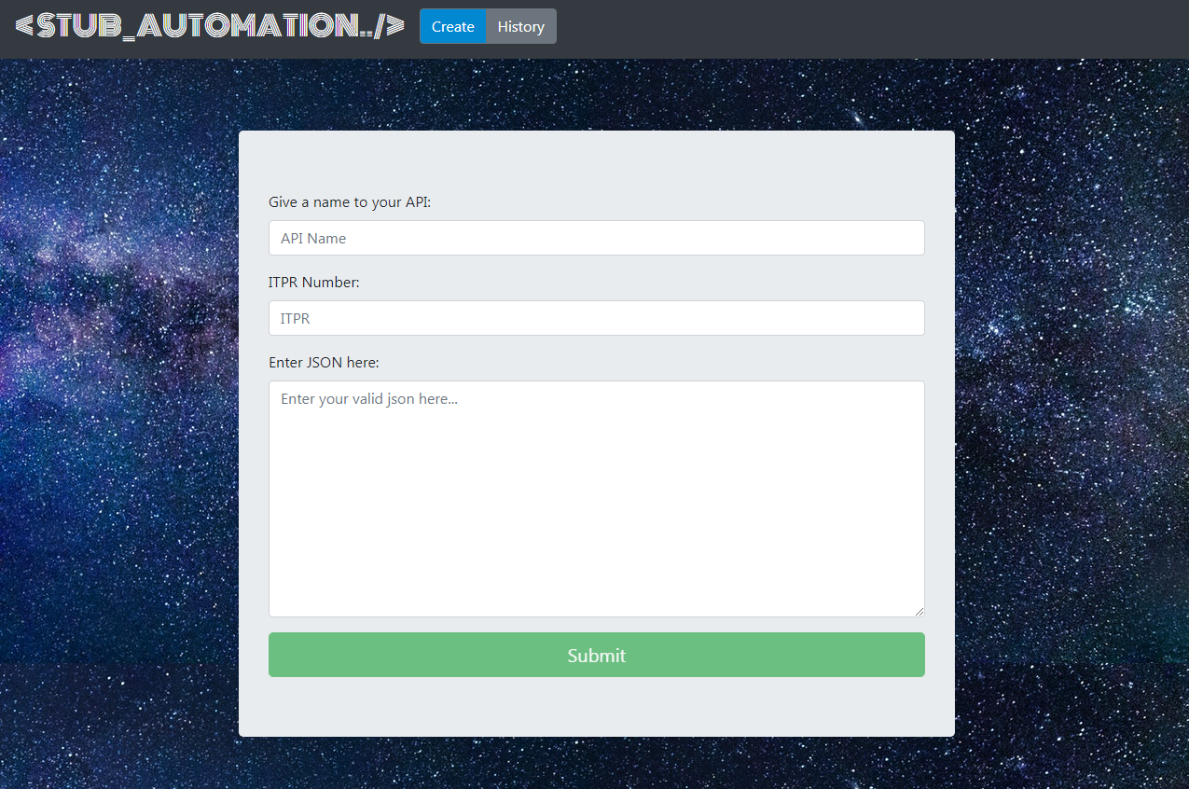
Stub creation Page

Slide 7
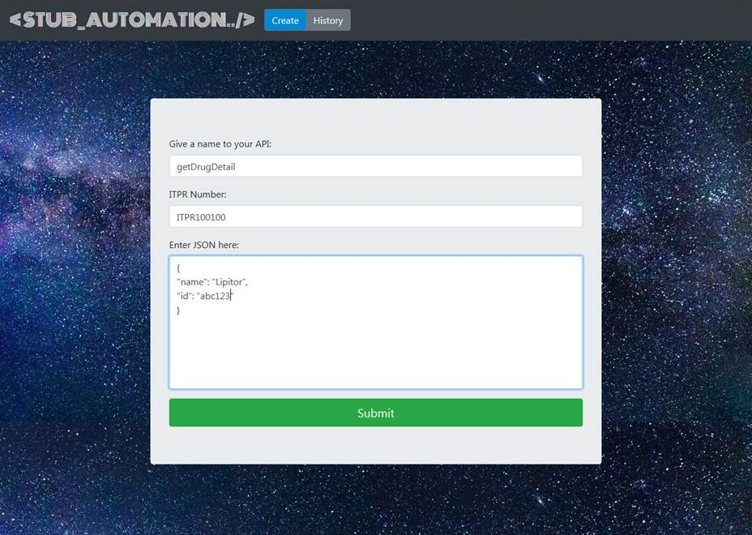
Stub creation Page: Input Parameters

Slide 8
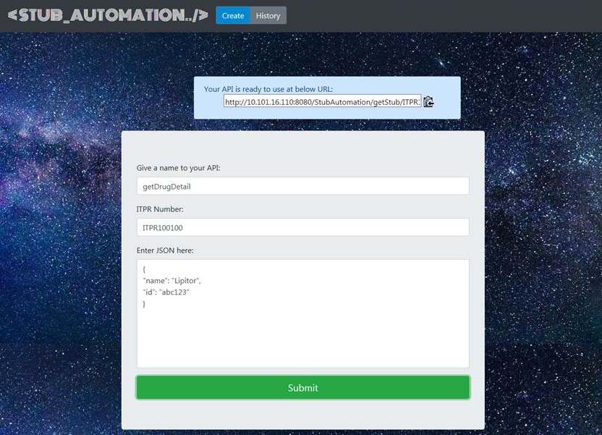
Stub creation Page: URL to stub JSON

Slide 9
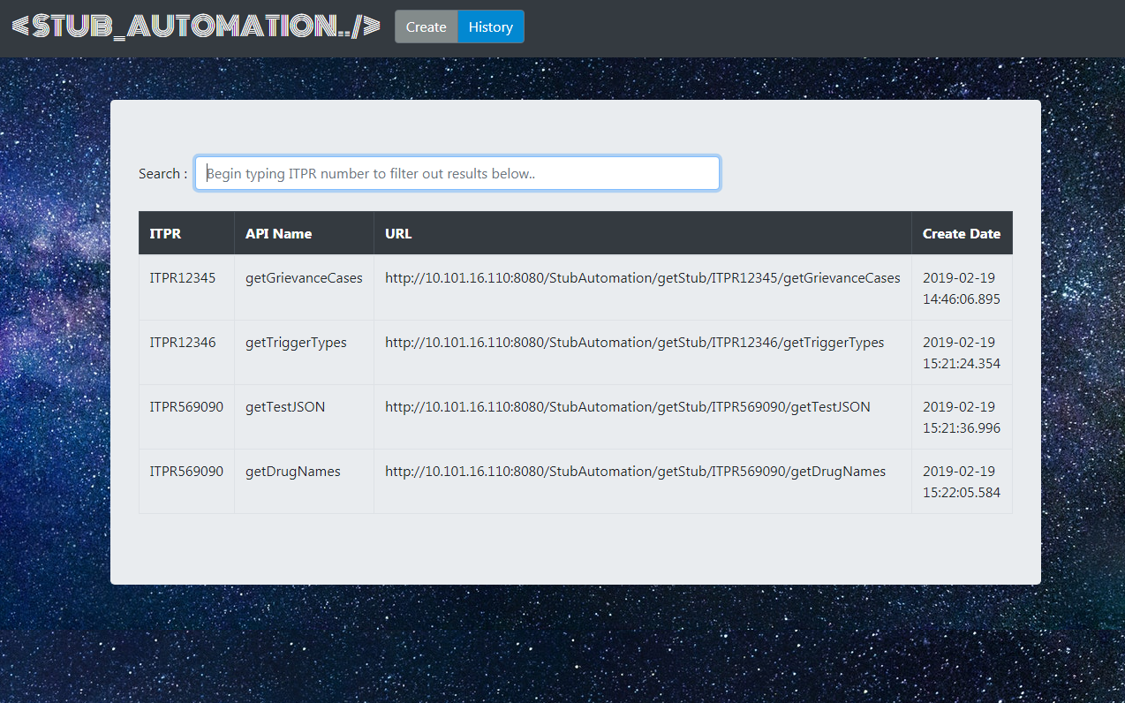
Stub History Page: List of URLs

Slide 10
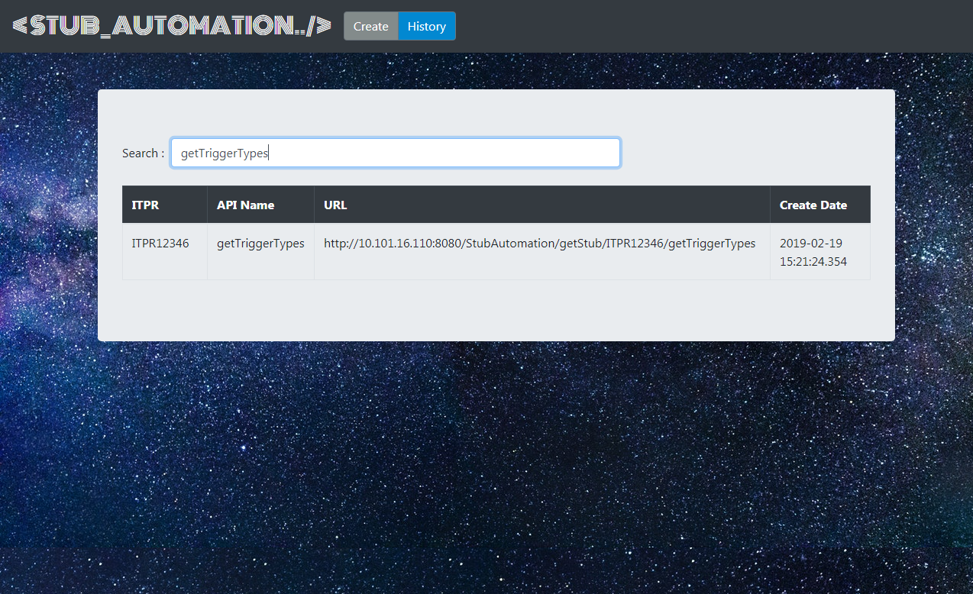
Stub History Page: Search Functionality

Slide 11
Future Enhancements
Update Functionality- User can update its existing stub as per the requirements and can access the updated stub on the same URL.
Delete Functionality- User can delete its existing APIs when no longer needed.

Slide 12
Thank You.

